Slide 1



Mentorness
HOTEL DATA
ANALYSIS
Presented By Mohamed Atef

Slide 2
AGENDA
Problem Statement
Geographical Insights
Pricing and Availability Analysis
Superhosts
Host Performance
Review Scores and Guest Satisfaction
Property Type and Room Analysis

Slide 3
PROBLEM STATEMENT
The given dataset shows data about different hosts for travelers in Australia. It shows hotels, apartments, hotels, private rooms, etc. The dataset also includes the hosts review, total listing counts and multiple other columns that can be used as metrics to identify the host’s performance

Slide 4
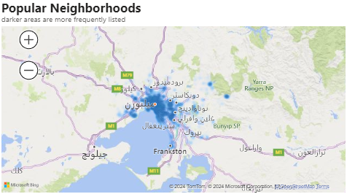
GEOGRAPHICAL INSIGHTS
After plotting the data on a map it showed that Melbourne has the most number of properties but they're not the most expensive. Dockland is the most expensive with an average price of 510$.
Hosts aren't only in Australia as they're spread around the world but most of them are in Australia and Europe.

Slide 5
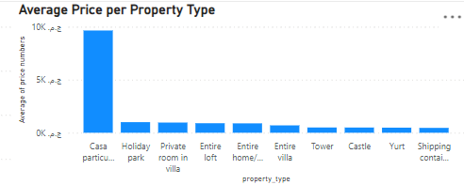
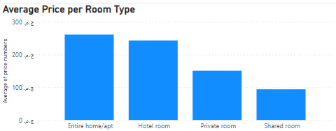
PRICING AND AVAILABILITY ANALYSIS
Casa Particular is shown to be the most expensive property type with an average of 9,652$.
The most expensive type of room was the Entire home/apt as it includes most of the expensive properties, especially Casa Particular

Slide 6




Respone Time
SUPERHOSTS
Most superhosts were replying to customers’ in less than an hour which may help new hosts to become superhosts.
An analysis was done to identify what characteristics affect the ability of a host to become a superhost.
The analysis took into consideration users’ reviews and the host’s actions like response time and methods of verification.
The results were as following
Verification Methods
The optimal number of verification methods that most superhosts has was 2.
Response Time and Listings
The host's response time didn’t affect the number of listings he received.

Slide 7
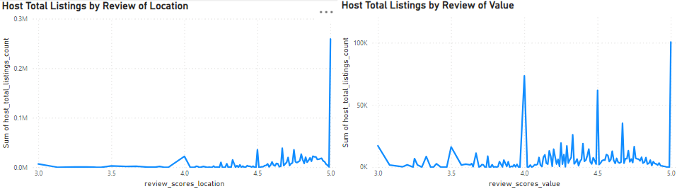
HOST PERFORMANCE
Customer reviews showed that almost all locations are highly rated and most of them got 5 stars so it doesn’t affect the host’s performance that much.
Most customer reviews gave 5, 4.5, or 4 stars for the value they got so most customers think the price is justified for what they get.

Slide 8

IMPROVEMENTS
Replying within an hour showed that it had no effect on the user’s review of the host communication so it’s not essential but can help make the host a superhost.
1
Upon analyzing customer reviews The areas of improvement showed to be little but can enhance the customers’ experience making them more willing to come again.
The most popular neighborhoods are the most highly rated so it will help a new host to get a place in these neighborhoods.
2
The price didn’t seem to have a relationship with the review a customer gave so there’s no particular price that can help.
3

Slide 9

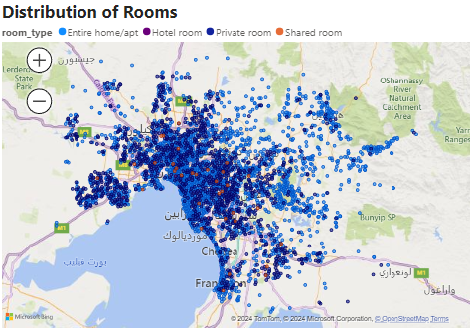
ROOMS DISTRIBUTIONS
Entire home/apts are concentrated in downtown and near Healesville.
Private rooms are around downtown and near Werribee.
Shared Rooms and Hotel Rooms are very sparse in the dataset.

Slide 10
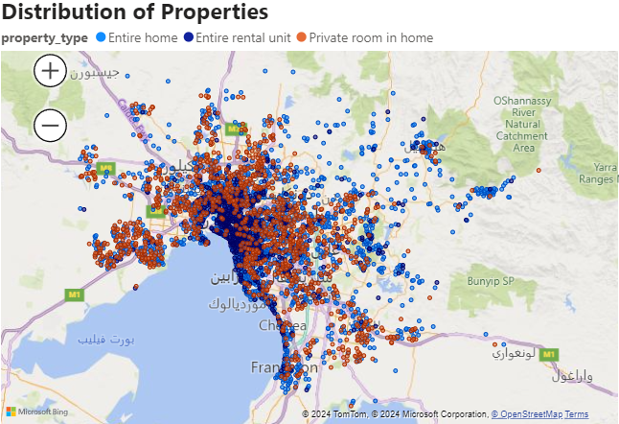
PROPERTIES DISTRIBUTIONS
Entire rental units are concentrated downtown.
Private rooms are around downtown and near Werribee.
Entire homes are very sparse in the dataset but they're near Healesville.

Slide 11
THANK YOU

